Slide 1
Spatial Similarity Experiment
Inout and SDR
Similarity table and graphs

Slide 2
Inout and SDR image
Created an images with increasing the number of non-zero input bits from 5% to 90 %.
Potential radius: Defines the radius in number of input cells visible to column cells.
To calculate Potential radius here is the formula mentioned in the code
PotentialRadius = (int)(potentialRadiusValue * inputBits)
where, input bits = image size * image size
PotentialRadiusValue = can mention different values to check the similarity
With 15* 15 pixel images (image size) , and few PotentialRadiusValue mentioned are 0.25, 0.3, 0.4, 0.45
When PotentialRadiusValue is 0.25 then by about equation the Potential Radius would be 56.
Similarity calculating for 0.3, 0.4, 0.45 the Potential Radius would be 67,90 and 101 respectively.

Slide 3






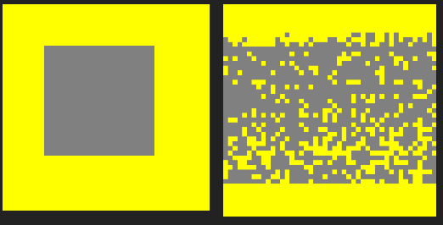



Inout and SDR images for below values.
LocalAreaDensity = 0.5, PotentialRadius= 56
I-00 I-01 I-02 I-03 I-04
I-05 I-06 I-07 I-08 I-09
Where, I-00 is first input image with 5% non-zero bits, I-02 is second input image with 10% non-zero bits,
Similarly , I-03 = 15% , I-04 = 25%, I-05 = 35%, I-06 =50%, I-07 = 65%, I-08 =80%, I-09 =90%

Slide 4
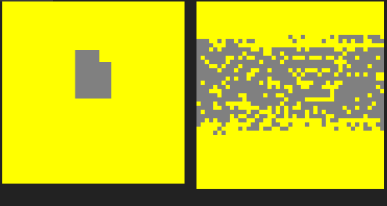









Inout and SDR images for below values.
LocalAreaDensity = 0.5, PotentialRadius= 67
I-00 I-01 I-02 I-03 I-04
I-05 I-06 I-07 I-08 I-09
Where, I-00 is first input image with 5% non-zero bits, I-02 is second input image with 10% non-zero bits,
Similarly , I-03 = 15% , I-04 = 25%, I-05 = 35%, I-06 =50%, I-07 = 65%, I-08 =80%, I-09 =90%

Slide 5










Inout and SDR images for below values.
LocalAreaDensity = 0.5, PotentialRadius= 90
I-00 I-01 I-02 I-03 I-04
I-05 I-06 I-07 I-08 I-09
Where, I-00 is first input image with 5% non-zero bits, I-02 is second input image with 10% non-zero bits,
Similarly , I-03 = 15% , I-04 = 25%, I-05 = 35%, I-06 =50%, I-07 = 65%, I-08 =80%, I-09 =90%

Slide 6










Inout and SDR images for below values.
LocalAreaDensity = 0.5, PotentialRadius= 101
I-00 I-01 I-02 I-03 I-04
I-05 I-06 I-07 I-08 I-09
Where, I-00 is first input image with 5% non-zero bits, I-02 is second input image with 10% non-zero bits,
Similarly , I-03 = 15% , I-04 = 25%, I-05 = 35%, I-06 =50%, I-07 = 65%, I-08 =80%, I-09 =90%

Slide 7
Similarity table and Graphs
For the Above SDR and Similarity table is drawn for each image compared with other image at different configuration value like potential radius, for example, image I-00 inout as well as SDR is compared with all the other images.
Where, I-00 is first input image with 5% non-zero bits, I-02 is second input image with 10% non-zero bits, Similarly, I-03 = 15%, I-04 = 25%, I-05 = 35%, I-06 =50%, I-07 = 65%, I-08 =80%, I-09 =90%
Column ‘Input’ = comparing the similarity of I-07 inout with other images inout
Column 'r' = comparison of SDR of image I-07 with other images SDR at Potential radius 45, 56, 67, 90,101

Slide 8
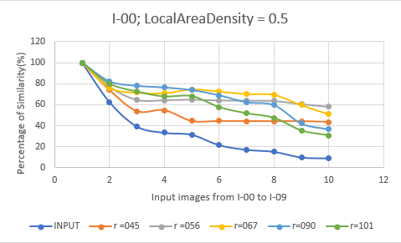
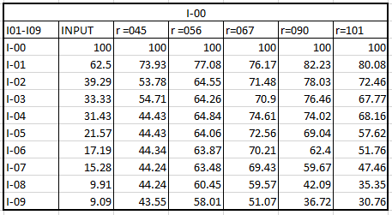
Similarity table and graph
Similarity table and graph for input image I-00 with other images (I-00 to I-09)
From the similarity percentage which is in the table, I have drawn a graph for better understanding.

Slide 9
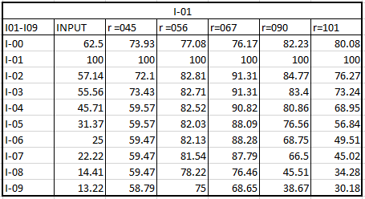
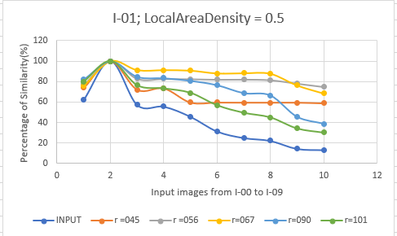
Similarity table and graph
Similarity table and graph for input image I-01 with other images (I-00 to I-09)
From the similarity percentage which is in the table, I have drawn a graph for better understanding.

Slide 10
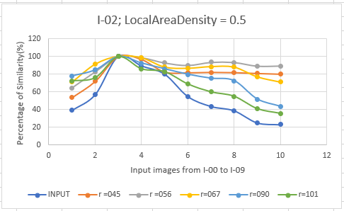
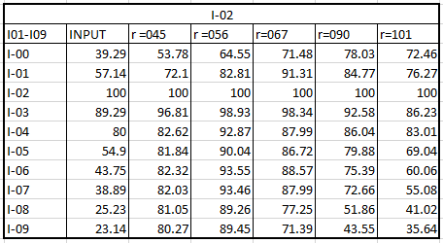
Similarity table and graph
Similarity table and graph for input image I-02 with other images (I-00 to I-09)
From the similarity percentage which is in the table, I have drawn a graph for better understanding.

Slide 11
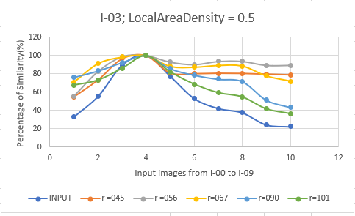
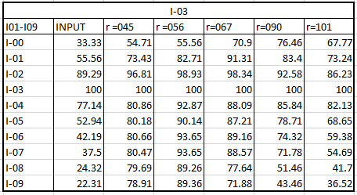
Similarity table and graph
Similarity table and graph for input image I-03 with other images (I-00 to I-09)
From the similarity percentage which is in the table, I have drawn a graph for better understanding.

Slide 12
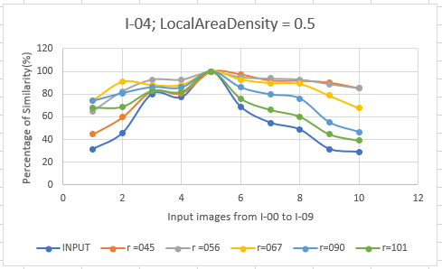
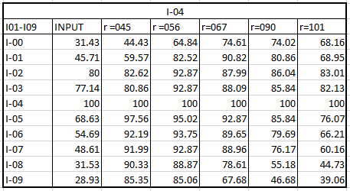
Similarity table and graph
Similarity table and graph for input image I-04 with other images (I-00 to I-09)
From the similarity percentage which is in the table, I have drawn a graph for better understanding.

Slide 13
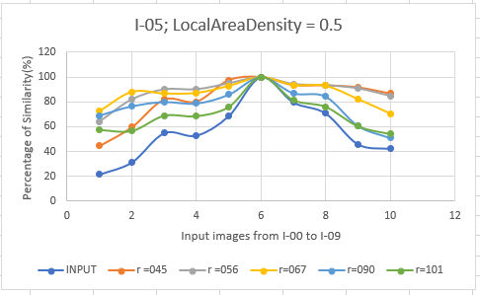
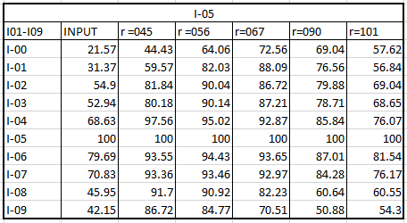
Similarity table and graph
Similarity table and graph for input image I-05 with other images (I-00 to I-09)
From the similarity percentage which is in the table, I have drawn a graph for better understanding.

Slide 14
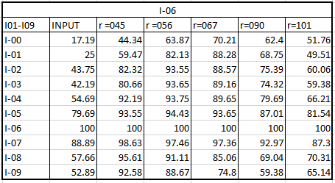
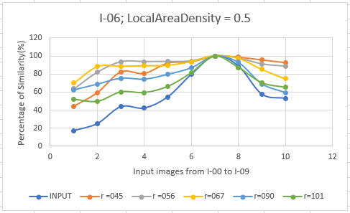
Similarity table and graph
Similarity table and graph for input image I-06 with other images (I-00 to I-09)
From the similarity percentage which is in the table, I have drawn a graph for better understanding.

Slide 15
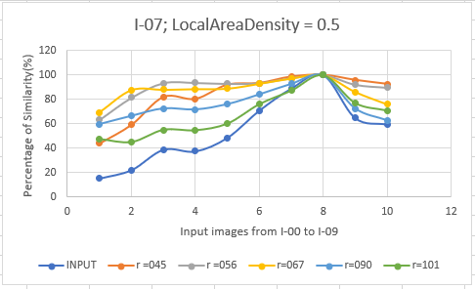
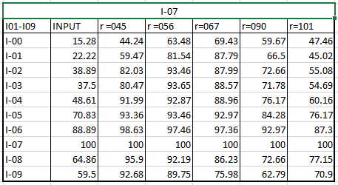
Similarity table and graph
Similarity table and graph for input image I-07 with other images (I-00 to I-09)
From the similarity percentage which is in the table, I have drawn a graph for better understanding.

Slide 16
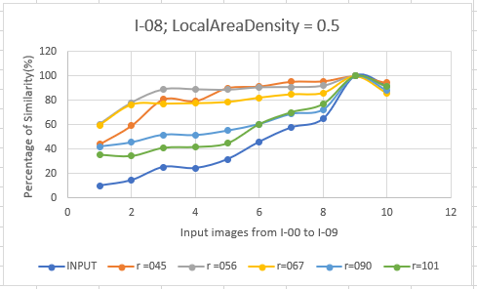
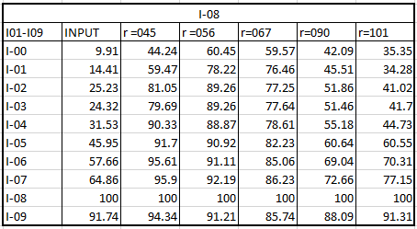
Similarity table and graph
Similarity table and graph for input image I-08 with other images (I-00 to I-09)
From the similarity percentage which is in the table, I have drawn a graph for better understanding.

Slide 17
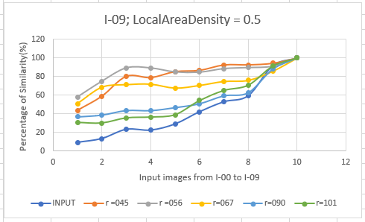
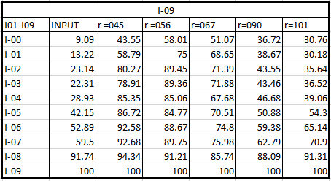
Similarity table and graph
Similarity table and graph for input image I-09 with other images (I-00 to I-09)
From the similarity percentage which is in the table, I have drawn a graph for better understanding.

